Slide 1
Summalyze
James ruben
Nithin tumma
Neel patel
Eddy Grafstein
Notes:
Allow customers browsing in stores to get flash deals for what they are looking at
What do you do not how do you do it.
Allows businesses to prevent walk out customers and engage users
Something about a landing page?
Plans of whatstores to hit in palo alto
Business plans. What it costs to get this customer—this is how wewill grow (small stores—eat costs for upgrading for wifi then target chains)
“ we thought about that but this iis why we didn’t awant to start off with it”
Market could be anyone that shops at a retail store
Calculate the numbers at the 15% loss. Not even including repeat customers.
Wifi is main behavior change
Data monetization
Selling: start off with small, then colelct data and make case studies, find the decision makers, do a pilot, each step of the way state hurdle. By the time we get to retail people are already used to using itin the smaller stores. Show that you arethinking about different strategies for large chains: attack baby chains first so thatthey have same customers as initial circle.
Push back will come around wifi and growth. The requirement of wifi is a hinderence to growth.showthat we are thinking about solving that problem.

Slide 2
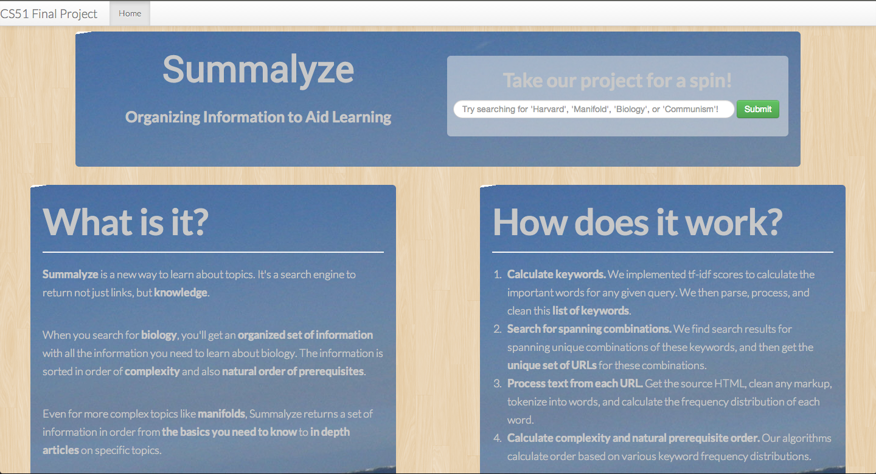
What We Did
Summalyze returns knowledge, not just URLs
Results in order of complexity + natural prerequisite order
Notes:
With Summalyze, when you search for a topic, we return everything you need to learn about that topic – in order of complexity, and also in the natural order of what you need to learn about first.

Slide 3


Tf-Idf: Determines Key Words
TF = term frequency
The occurrence of a term in this document
IDF = inverse document frequency
Occurrence of term across all documents (corpus)
TF-IDF Score
High tf-idf scores indicates a keyword

Slide 4
Summarability Score
A measure of complexity
Compared frequency distribution of keywords in wiki vs article
Similar distribution = similar to summary = low complexity
Different distribution = more in depth on a topic = high complexity

Slide 5
Amount Seeking + Other Help
We’re not capital intensive yet
Looking for mentorship, feedback, retail connections
Mainly, we just love the RDV team

